Slide 1
CALORIE ADVISOR APPLICATION USING
GEMINI PRO VISION.

Slide 2
1.
ROSHINI RAJA
2116210701216
Team Members:
2.
SELVAN NANDHINI S 2116210701237
3.
SHAMINI P N
2116210701239

Slide 3
Abstract
Objectives
Introduction
Existing System
Agenda
Proposed System
System Architecture
Technology
Modules
Output Screenshots
Conclusion
References

Slide 4
In the modern world, maintaining a healthy lifestyle is becoming increasingly challenging due to busy schedules, easy access to processed foods, and a lack of nutritional education
Many individuals struggle to track their caloric intake and expenditure accurately, leading to difficulties in achieving and maintaining a healthy weight.
Low motivation and adherence to tracking and dietary plans over time.
Lack of engaging and interactive features to sustain long-term user involvement
PROBLEM STATEMENT

Slide 5
ABSTRACT
Diet control is one of the sub-procedures of fitness as
well as a management technique for chronic conditions.
Calorie Advisor is an AI-powered nutrition assistant that provides personalized dietary recommendations based on individual health goals and preferences
By analyzing user data, it suggests optimal calorie intake and nutrient balance to promote healthy eating habits and achieve weight management, fitness, and wellness objectives efficiently.
.

Slide 6

objectives
Estimate Calorie count
User-friendly and advises healthy or not
Promote informed eating

Slide 7

Existing System
Traditional dietition.
Noom-This app include a high subscription cost, initial setup and login is time-consuming
Myfitnesspal-The app overestimates calorie needs, because it overestimates calories burned from activity
Fatsecret-This app include a less user-friendly interface compared to other apps, potentially making it harder to navigate.

Slide 8



Proposed System
Our Calorie Advisor Web application is developed using Gemini Pro.
Our Caltrack interacts with user and provides the amount of calorie present in the food they consume.
It is available 24/7 so the user can use it anytime.
User can upload images and get response of calorie count.
Free cost for all users

Slide 9
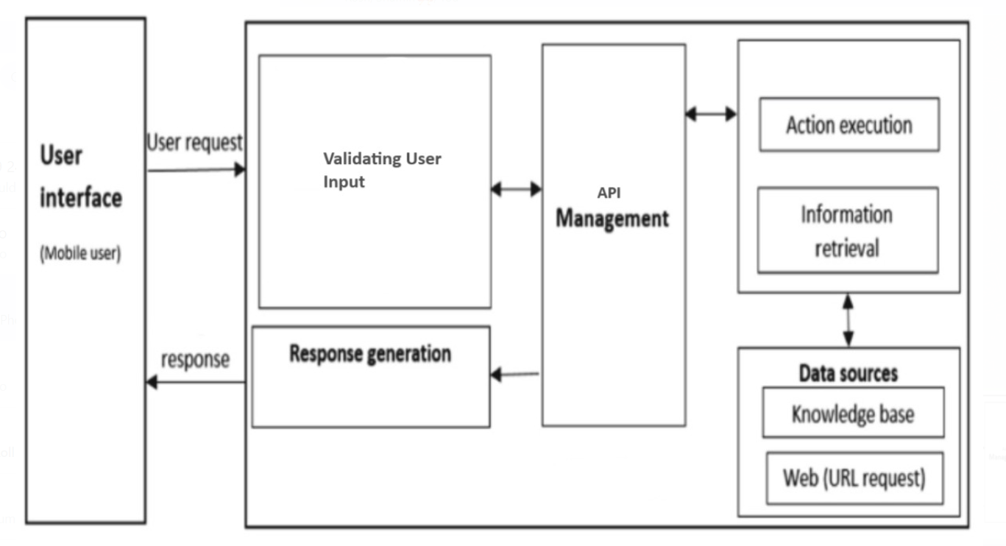
System Architecture

Slide 10
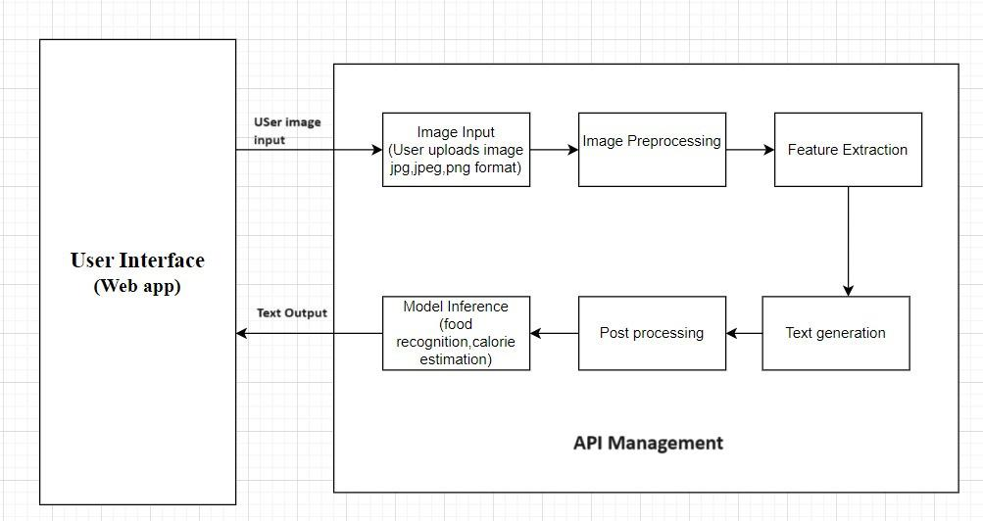
System Architecture

Slide 11

Technology used

Slide 12




TECHNOLOGY USED
Google’s Gemini-Pro-Vision
Streamlit
Generative AI
Multimodal LLM generates various output.
good benchmark
Open-source python library
To built attractive UI in no time
No prior experience in front-end
Compatible with major Libraries

Slide 13

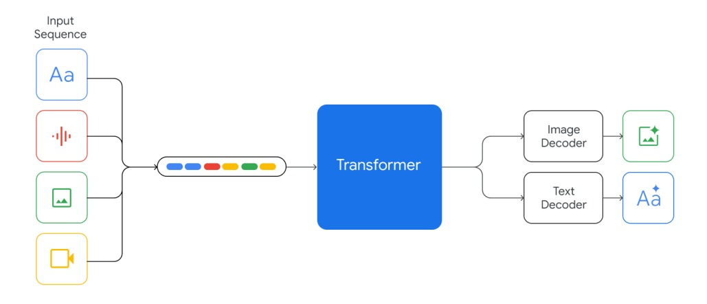
Gemini Diagram

Slide 14
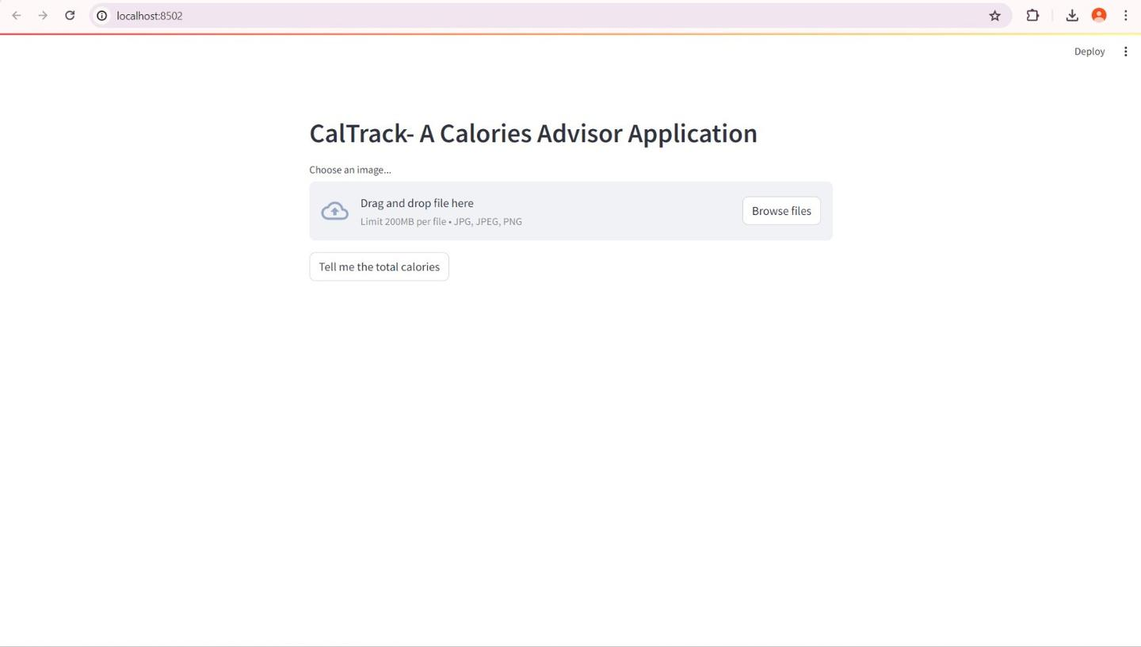
Modules
UserInteraction page where the user interacts with the web page and the input is processed to get the output
Fig 1.

Slide 15
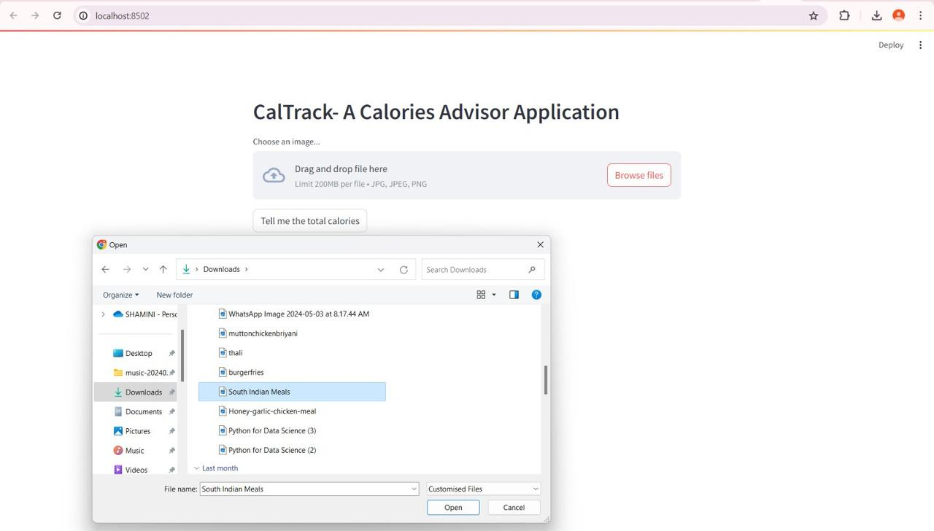
The user can upload the food image by clicking on browser file, where the file opens in their desktop.The user select the desired image and click open.
Fig 2.

Slide 16
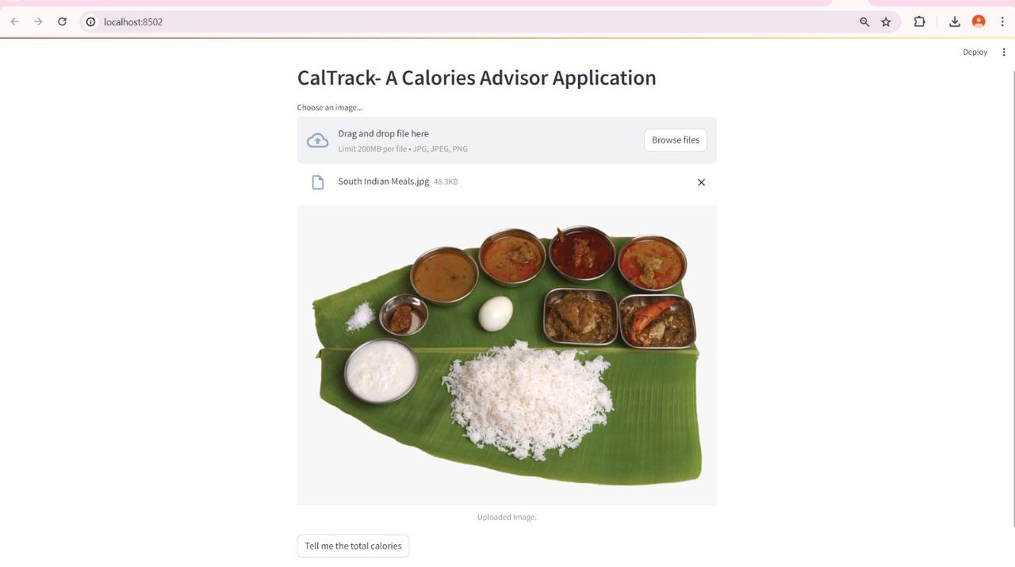
The chatbot response interface in our mental health chat app offers real-time support,
confidential space for individuals to share their thoughts and feelings.
Fig 3

Slide 17
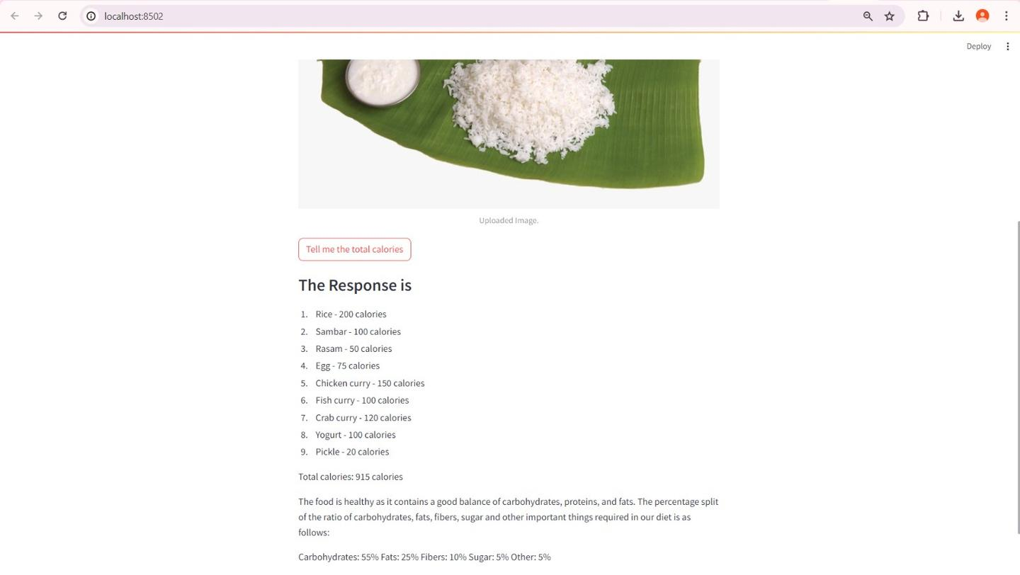
RESULTS:
The Image is seen and By clicking the prompt button , the application generates the response based on the image uploaded
Fig 4

Slide 18
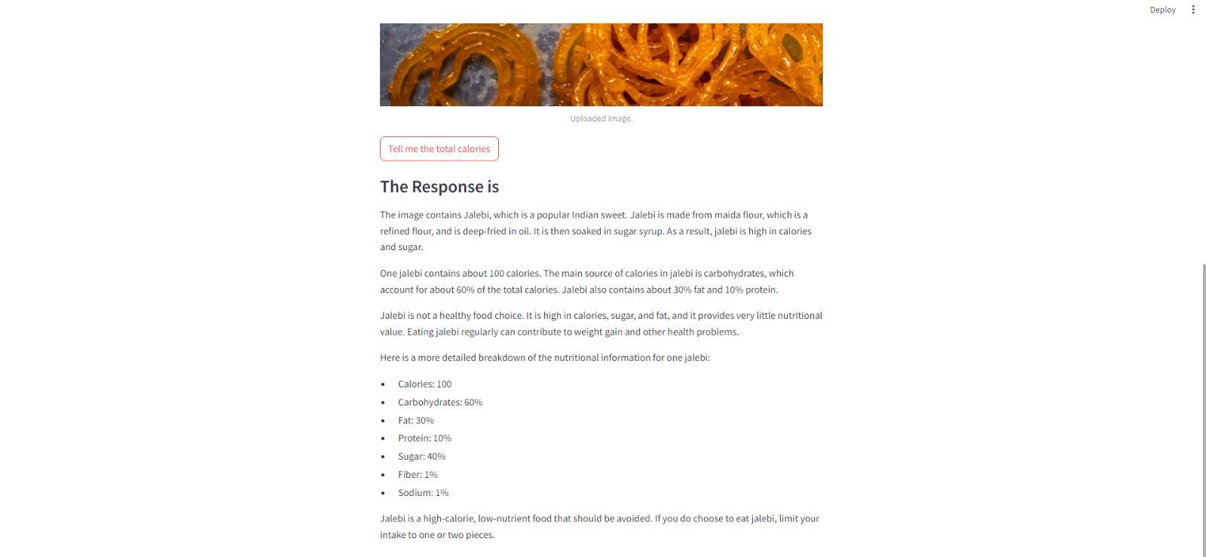
The response contains the information of list of the food items in the image and their estimated calories count. It is also states whether it is healthy or not
Fig 5

Slide 19

Conclusion:
Our findings provide new information about how calories are estimated from food images, which can inform the design of related software and analyse.
These results imply that calorie labeling alone may not be enough to make sustainable reductions in calorie intake in fast food restaurants.
It should however be noted that when applied to calorie advising the machine learning for a calorie advising system has the capacity to establish nutrition recommendations that are learning for the individual.

Slide 20

Future enhancements
Live detecting
personalised recommendations

Slide 21
REFRENCES
https://www.researchgate.net/publication/379171804_Gemini_or_ChatGPT_Capability_Perfor mance_and_Selection_of_Cutting-edge_Generative_Artificial_Intelligence_AI_in_Business_Ma nagement
https://www.healthline.com/nutrition/noom-diet-review#recommendation
https://www.researchgate.net/publication/377963001_Effect_of_FatSecret_App_Implemen_on_Increased_Physical_Activity_and_Weight_Loss
https://www.jmlr.org/papers/volume12/collobert11a/collobert11a.pdf
https://www.researchgate.net/publication/377530197_Multimodal_analysis
https://ieeexplore.ieee.org/document/8269806
https://www.researchgate.net/publication/361136117_A_Survey_on_IBM_Watson_and_Its_S ervices
https://www.researchgate.net/publication/346111006_Overview_of_the_Transformer-based_ Models_for_NLP_Tasks

